Slide 1

Workshop Housekeeping Python Fundamentals for Engineers and Manufacturers

Slide 2


Hosted By
Workshop repo
http://bit.ly/2opFlZ6
SME Chapter 112
Chicagoland
SME Chapter 430
Greater Charleston

Slide 3




SME Virtual Network
This is the best place to start!
http://bit.ly/2DlFGm3
https://www.linkedin.com/company/smevirtual/
https://www.facebook.com/smevirtual/

Slide 4
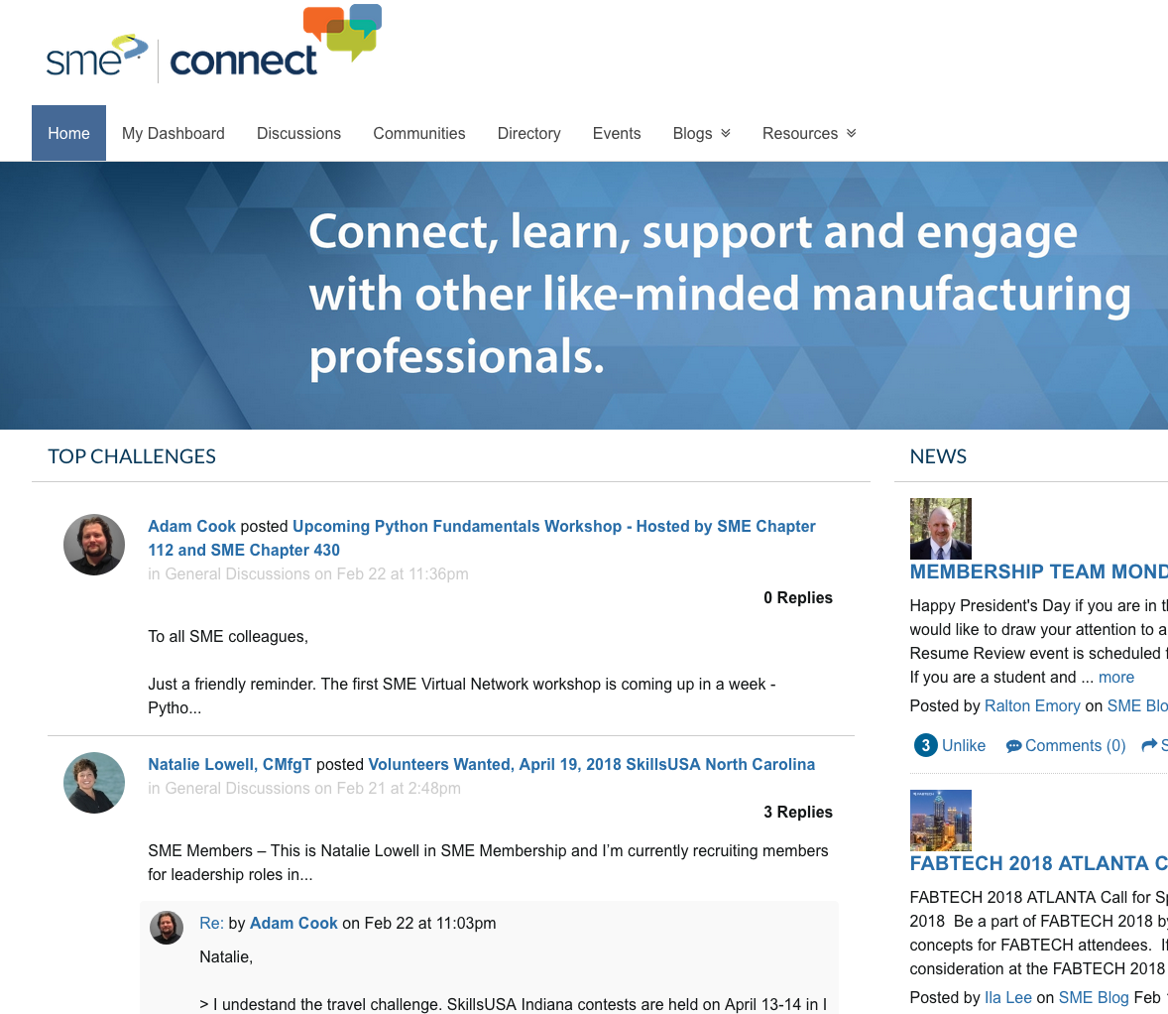
SME Connect and Slack
SME Connect
SME Virtual Network Slack
Are you an SME member? Request an invite here:
http://bit.ly/2BpjMiE

Slide 5
Where is all the info for this workshop?
http://bit.ly/2opFlZ6
All code is licensed under The MIT License.
All written content is licensed under Creative Commons Attribution 4.0 International Public License.

Slide 6
SME and SME Membership
Workshop repo
http://bit.ly/2opFlZ6
Inspire, Promote and Advance Manufacturing Technology to future generations.
Want to learn more about
?
Check out sme.org

Slide 7












Why you might use Python?
Workshop repo
http://bit.ly/2opFlZ6

Slide 8
Why else?
Workshop repo
http://bit.ly/2opFlZ6
Python is versatile.
Python is accessible.
Python is fun.

Slide 9
Where do we go from here?
Workshop repo
http://bit.ly/2opFlZ6
Open-source projects on GitHub
Targeted webinars on YouTube
Real-world, industry use-cases on YouTube
Industrial hardware/software hackathons
Virtual assistance with SME student chapter projects.
Python | Data analysis, machine learning research and web applications.
C# | Motion controls, PAC programming and robotics development.
C++/C/Rust/Qt | Embedded systems programming and GPU/GPGPU programming.
Go/Typescript | High-throughput industrial applications (e.g. real-time data ingestion).
Java/Kotlin/Swift | Industrial mobile applications for iOS and Android.

Slide 10
Feedback
Workshop repo
http://bit.ly/2opFlZ6
We
feedback and suggestions!
http://bit.ly/2G42GXy

Slide 11
Workshop Outline – Day 1
Workshop repo
http://bit.ly/2opFlZ6
Introduction to Git.
Introduction to the Python interpreter and pip ecosystem.
Introduction to Jupyter Notebooks.
Data types and objects.
Reading and writing data.
Control flow.
Loops and iterables.
Functions.
Classes.
Packages.
There will be do-it-yourself challenges throughout!

Slide 12
Workshop Outline – Day 2
Workshop repo
http://bit.ly/2opFlZ6
Documentation.
Testing.
Debugging.
Profiling.
Network communication.
Data exploration and visualization (with NumPy and Pandas).
There will be do-it-yourself challenges throughout!

Slide 13
Workshop Outline – Day 3
Workshop repo
http://bit.ly/2opFlZ6
Concurrency and parallelism.
Hardware description and verification (HDL).
Computational geometry (pretty good video here).
Image manipulation and machine vision.
Neural networks (CNN or ConvNet).
Check out the TensorFlow Playground.
There will be do-it-yourself challenges throughout!

Slide 14
Python Setup Help
Workshop repo
http://bit.ly/2opFlZ6
http://bit.ly/2sslEEA
or
SME Connect and Slack

